Slide 1
Furthering Your Education

Slide 2

MIKE
Notes:
“This is Mike. He wants to be a mechanic.”

Slide 3

MIKE
Notes:
“If he goes to vocational school, he can work in a shop.”

Slide 4
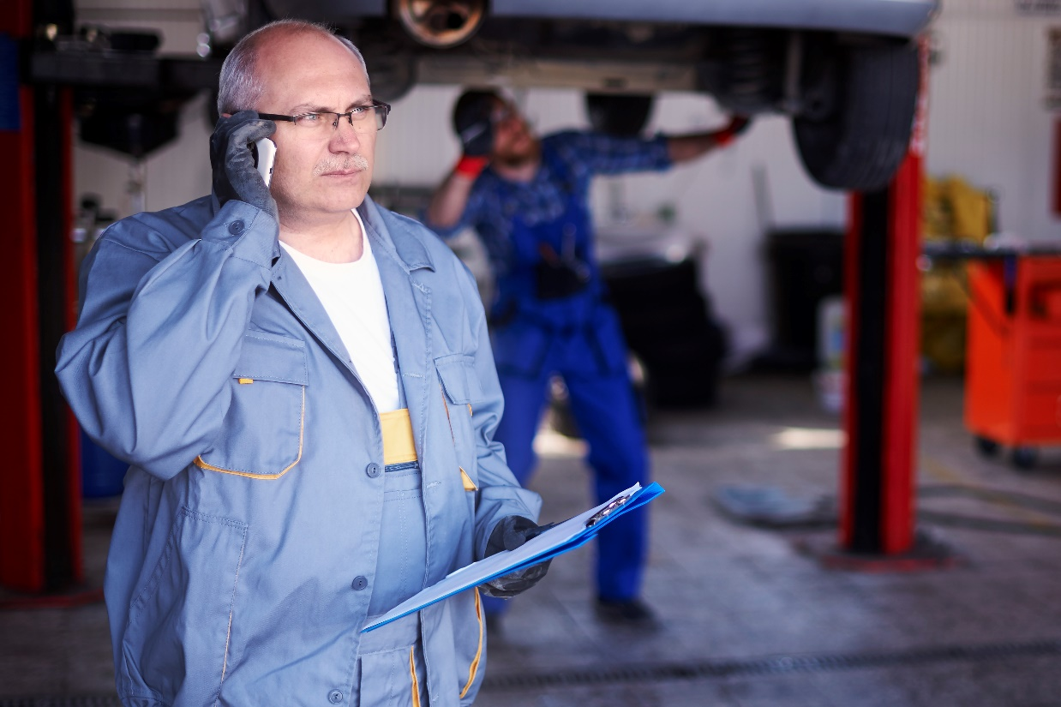
MIKE
Notes:
“If he goes to a four-year university, he can own his own shop.”

Slide 5

CYNTHIA
Notes:
“This is Cynthia. She is in law school.”

Slide 6

CYNTHIA
Notes:
“If she gets her degree, she will be able to get a job as a lawyer.”

Slide 7

CYNTHIA
Notes:
“If she does well as a lawyer, she will be able to own her own law firm.”

Slide 8

ANDREW
Notes:
“Andrew is working to get his high school equivalency (HSE).”

Slide 9
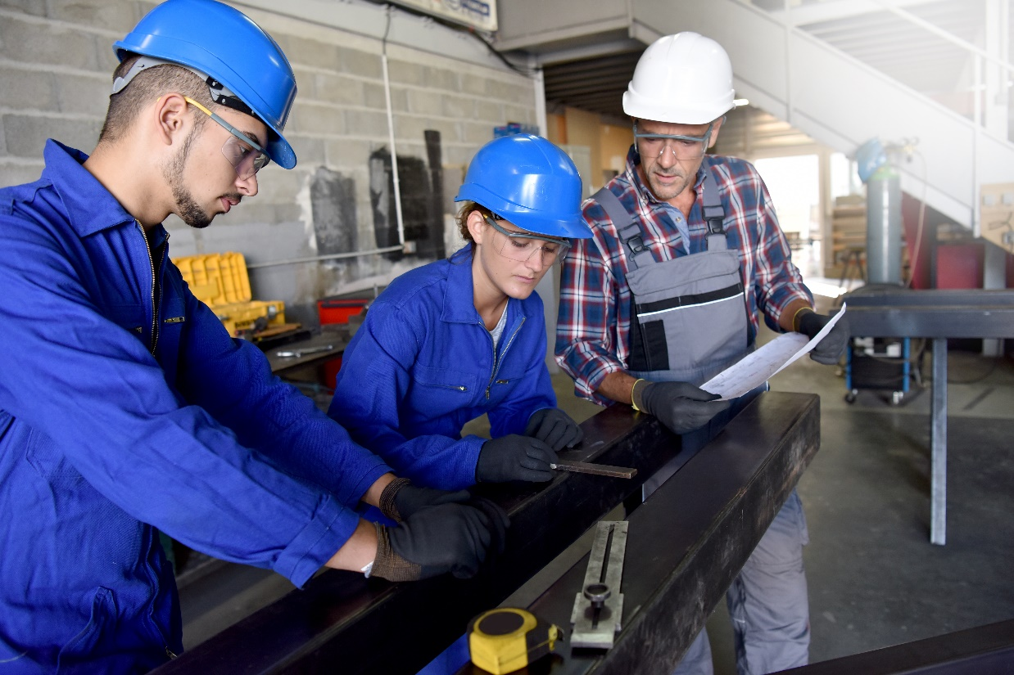
ANDREW
Notes:
“If he gets his HSE, he will be able to go to trade school.”

Slide 10

ANDREW
Notes:
“If he goes to trade school, he will be able to become a welder and earn very good money.”

Slide 11

SAMANTHA
Notes:
“This is Samantha. She is a nurse.”

Slide 12

SAMANTHA
Notes:
“If she gets into medical school, she will be able to get a job in a hospital.”

Slide 13

SAMANTHA
Notes:
“After she gets her MD, she will be able to work as a doctor.”

Slide 14
MIKE
This is Mike. He wants to be a mechanic.
Notes:
“This is Mike. He wants to be a mechanic.”

Slide 15
MIKE
If he goes to vocational school, he can work in a shop.
Notes:
“If he goes to vocational school, he can work in a shop.”

Slide 16
MIKE
If he goes to a four-year university, he can own his own shop.
Notes:
“If he goes to a four-year university, he can own his own shop.”

Slide 17
CYNTHIA
This is Cynthia. She is in law school.
Notes:
“This is Cynthia. She is in law school.”

Slide 18
CYNTHIA
If she gets her degree, she will be able to get a job as a lawyer.
Notes:
“If she gets her degree, she will be able to get a job as a lawyer.”

Slide 19
CYNTHIA
If she does well as a lawyer, she will be able to own her own law firm.
Notes:
“If she does well as a lawyer, she will be able to own her own law firm.”

Slide 20
ANDREW
Andrew is working to get his high school equivalency (HSE).
Notes:
“This is Andrew. He is getting his high school equivalency (HSE).”

Slide 21
ANDREW
If he gets his HSE, he will be able to go to trade school.
Notes:
“If he gets his HSE, he will be able to go to trade school.”

Slide 22
ANDREW
If he goes to trade school, he will be able to become a welder and earn very good money.
Notes:
“If he goes to trade school, he will be able to become a welder and earn very good money.”

Slide 23
SAMANTHA
This is Samantha. She is a nurse.
Notes:
“This is Samantha. She is a nurse.”

Slide 24
SAMANTHA
If she gets into medical school, she will be able to get a job in a hospital.
Notes:
“If she gets into medical school, she will be able to get a job in a hospital.”

Slide 25
SAMANTHA
After she gets her MD, she will be able to work as a doctor.
Notes:
“After she gets her MD, she will be able to work as a doctor.”

