Slide 1

English Forward
Teaching conversation skills in the beginning ESL classroom
Notes:
Time Allotted: 3 minutes
Supplies:
Training Materials:
Handouts:
Guide Pages:
Presentation Notes:
Welcome & Introductions
Welcome everyone and thank them for attending
Ask for a little information about your audience. Are they instructors? Program Staff? Administrators?
Presenter introduction
Give a brief description of the Literacy Coalition and the Literacy Forward program.
Literacy Coalition:
- Nonprofit founded in 2001
Mission: to improve the quality and availability of literacy instruction for Central Texans
An umbrella organization that supports over 40 literacy agencies and programs by providing: resources, training, research, advocacy, and client and volunteer referrals
Literacy Forward:
Improves the quality of instruction happening in adult literacy classrooms through trainings, resource development, and technical support.
English Forward: a program of Literacy Forward targeted at adult ESL programs
To learn more about the Literacy Coalition, direct participants to our website.
Give a brief overview of the Dollar General funding and how the national venture has worked so far

Slide 2
English Forward Training System
Developed by the Literacy Coalition of Central Texas in collaboration with Dr. Heide Spruck Wrigley
1st edition developed in 2008; 3rd (current) edition developed in 2012; training system replication piloted nationwide in 2013
Reflects the most recent research in the field of adult second language acquisition
Developed with input from students, teachers, and programs
Developed at the request of and to meet the needs of community-based organizations
  Limited resources
  Volunteer instructors with no prior teaching experience
Notes:
Time Allotted: 2 minutes
Supplies:
Training Materials:
Handouts:
Guide Pages:
Presentation Notes:
Say “Today, we wanted to give you an overview of English Forward, a handful of strategies, and a sample lesson that we can take with you,” and “if you want to learn more or get involved, I’ll be telling you more about that at the end of this session.”
Briefly explain the English Forward Training System by reviewing the slide.
Refer participants to the web portal for more detailed information about the English Forward Training System.

Slide 3

Principles of Language Acquisition and
Adult ESL Learning
Test your knowledge!
Strategies: True/False Quiz, Signal Cards
Notes:
Time Allotted: 3 minutes
Supplies: red/green/yellow construction paper, scissors
Training Materials: Signal Cards
Handouts:
Guide Pages: 65-66
Presentation Notes:
Strategy: Signal Cards
Introduce Signal Cards to the participants and explain the meaning of the cards.
Classroom Application Tip: To save prep. time before class, have the students cut up the Signal Cards in class.

Slide 4


Principles of Language Acquisition and
Adult ESL Learning
Memorization is the most important skill in learning a new language.
Group and pair work should make up about 70% of class time in the language learning classroom.
Teachers should provide a risk-free environment in the classroom.
As a teacher you should be sure to correct learner mistakes. This ensures students don’t incorrectly learn language structures. Once learned, language structures are difficult to unlearn.
Strategy: Signal Cards
Notes:
Time Allotted: 5 minutes
Supplies:
Training Materials: Signal Cards, Principles Governing Adult ESL Learning Answer Key
Handouts:
Guide Pages: 116-123
Presentation Notes:
Strategy: Signal Cards (continued)
Using the Answer Key, review each question as a class. Ask participants to hold up a red, green, or yellow card for each question.
Discuss each question as you go, clicking to progress the bullet points on the slide after each question.

Slide 5
Principles of Language Acquisition and
Adult ESL Learning
5. Students learn best in an environment that is predictable and consistent. Teachers should make sure to provide the same types of interactions with English throughout a class period. For example, if the emphasis of the lesson is on reading, all activities should be focused on reading.
6. Teachers should confine language lessons to the classroom where the teacher is able to control the language input and ensure a safe space conducive to learning.
7. It will take an adult with no knowledge of English on average 6 years to learn the language.
8. Adult learners are highly goal driven. Student goals and interests should be taken into account when lesson planning.
Strategy: Signal Cards
Notes:
Time Allotted: 5 minutes
Supplies:
Training Materials: Signal Cards, Principles Governing Adult ESL Learning Answer Key
Handouts:
Guide Pages: 116-123
Presentation Notes:
Strategy: Signal Cards (continued)
Using the Answer Key, review each question as a class. Ask participants to hold up a red, green, or yellow card for each question.
Discuss each question as you go, clicking to progress the bullet points on the slide after each question.
Ask participants how this activity would help new instructors begin to learn about and build awareness of adult education and ESL students
Ask participants how using T/F and Signal Cards can be helpful in teaching ESL students

Slide 6
Who are your students?
What characteristics might you find in an ESL student population?
Strategy: Brainstorming
Notes:
Time Allotted: 8 minutes
Supplies: plain white paper
Training Materials:
Handouts:
Guide Pages: 10-11, 35-36
Presentation Notes:
Say, “Let’s think now about WHO are our students? How do you define them? What are some characteristics common to the ‘typical’ ESL student?”
Strategy: Brainstorming; Activity: Snowball Fight
Conduct the Snowball Fight Activity:
Pose the question: “What characteristics might you find in an ESL student population?”
Give participants 2 minutes to write down on plain paper 3 characteristics they may find in an ESL student population.
Divide the classroom in half and have half of the participants stand on one side of the room and the remaining half on the other side of the room.
Instruct participants to crumble their paper into a ball and simulate a “snowball” fight for 30 seconds.
When you call “time!” each person should have one piece of paper.
Call on random people to read the responses on the paper.
After each response is read, ask the participants to raise their hands if they have a similar response on their paper.
Repeat step 6-8 three to five times.
At the end, ask if there is anyone whose response has not been covered and invite them to share.
Classroom Application Tip: Ask how an activity such as this could be useful with low-level ESL students. Possible answers include showing comprehension without needing to speak (reception precedes production), creating anonymity, and using as a match-up activity where students find their match.
Presentation Tip: Ask how an activity like this could also be helpful for training instructors and/or volunteers.

Slide 7
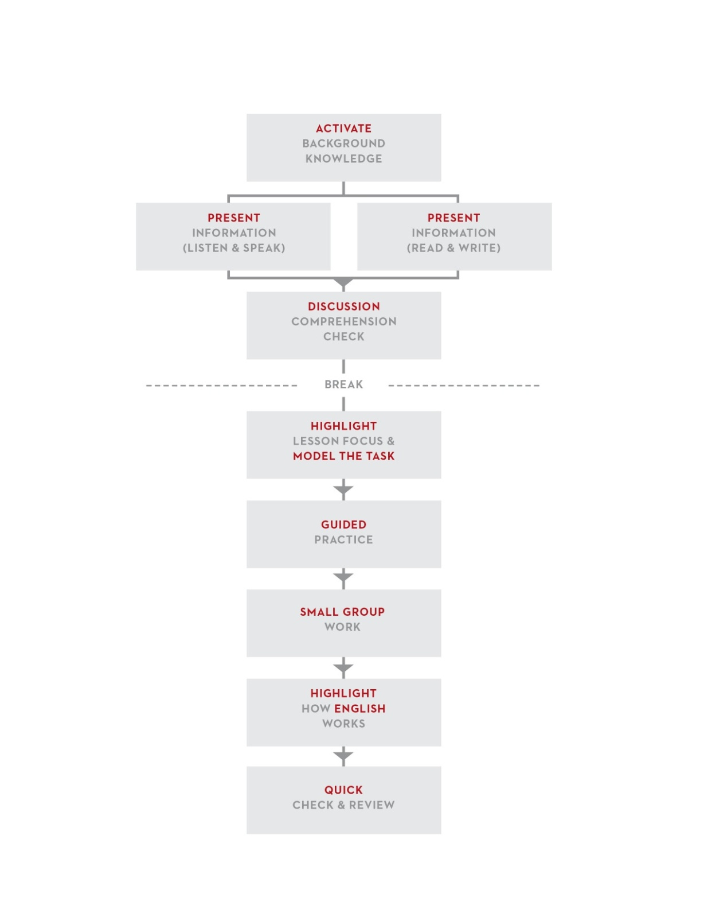
The Lesson Flow
Lesson Flow adapted from ESL by Design by Literacywork International
Notes:
Time Allotted: 10 minutes
Supplies:
Training Materials:
Handouts: The Lesson Flow
Guide Pages: 99-113 (Section 3)
Presentation Notes:
Pass out the Lesson Flow handout.
Give a brief overview into the background of the Lesson Flow, highlighting the following points:
The entire English Forward training system, including the Lesson Flow, builds upon research and promising practices gathered from studies in cognitive sciences, second language acquisition, learning theory, and adult ESL Literacy.
It is a strategy-based approach to ESL instruction that can be applied for a variety of ESL levels.
It can be used by both experienced and new instructors.
Within a two-hour class period, instructors are encouraged to go through the lesson flow once and focus on listening and speaking and then go through the flow a second time and focus on reading and writing.
It is meant to be flexible and not content specific. It is intended to provide a framework for ESL instruction that can be manipulated to meet the specific needs of teachers and students.
The English Forward training system focuses on teaching oral communication skills; therefore, the training and accompanying Curriculum focus on the listening and speaking side of the diagram.
Provide a brief description of each step, as there likely will not be time to discuss each step in detail.
Direct participants to the Guide for more detailed information.

Slide 8
The Curriculum
Notes:
Presentation Notes:

Slide 9

The English Forward Curriculum
Overview:
Developed in 2012; 3rd edition of the training system
Developed at the request of CBOs
  and with their needs in mind
Developed in consult with Dr. Heide Wrigley
Only available to English Forward-trained instructors
Notes:
Time Allotted: 2 minutes
Supplies:
Training Materials:
Handouts:
Guide Pages:
Curriculum Pages: 5-6
Presentation Notes:
Introduce the EFC by briefly covering the following points on the slide:
It was developed by the Literacy Coalition in 2012 as part of the 3rd edition of the training system
It was developed at the request of community-based programs with their needs in mind: limited resources and mostly volunteer instructors
It was developed in consult with Dr. Heide Wrigley.
Effectively implementing the EFC requires those using it to already be familiar with many of the principles covered during the English Forward Instructor Training, such as the Lesson Flow and teaching strategies. Therefore, it is only available to those instructors who attended the 2-day instructor training.
Direct participants to the EFC pgs. 5-6.

Slide 10

Guiding Principles
Beginning ESL classrooms
60-100 hours of instruction
Focus on oral communication
Flexibility
Review. Every class.
6. Timing
7. Model, model, model!
8. Peer-to-peer interactions
9. Student talk time
10. Supplemental materials
Notes:
Time Allotted: 10 minutes
Supplies:
Training Materials: English Forward Curriculum, EFC Guiding Principles
Handouts:
Guide Pages: 27-28
Curriculum Pages: 5-6, 23-27
Presentation Notes:
Beginning ESL classrooms: Low/high beginning according to the NRS; SPLs 2-3.
60-100 hours of instruction: This is including the extensive number of Extension Activities. (Note to trainers: The EFC covers the first 60-100 hours of instruction because studies show this is the average amount of time students are with a program.)
Focus on Oral Communication: The EFC does not have an accompanying student workbook. This is intentional. The purpose of a workbook is usually writing practice, and since the Curriculum both focuses on oral language skills and is meant to be tailored for each individual class and program, a workbook would be counter to the EFC Guiding Principles.
4. Flexibility:
Incorporating textbooks: Refer back to the pictures Karen uses throughout the lesson demonstration. Many were taken from the textbook her class was using.
Adapting the lessons to make them your own
5. Reviewing
6. Timing
7. Modeling:
8. Peer-to-Peer Interaction
9. Student Talk Time
Supplemental Materials:
Show the icon that designates a Supplemental Material and show participants where to find supplemental materials on the portal (if you didn’t already do this during the web portal overview).

Slide 11
Lesson Flow Demonstration – Step Two
Notes:
Time Allotted: 10 minutes
Supplies:
Training Materials:
Handouts: The Lesson Flow, Lesson 4.3 Symptoms and Medications
Guide Pages: 99-113 (Section 3)
Presentation Notes:
Remind participants that Step Two is where the instructor presents information. This step is where instructors introduce the language and vocabulary that the students will need to use later in the lesson.
Pass out copies of Lesson 4.3, Symptoms and Medication
Have participants look over step two before watching the video
Direct participants to the Guide for more detailed information.

Slide 12

Literacy Forward Web Portal
www.literacyforward.org
Notes:
Time Allotted: 5 minutes
Supplies:
Training Materials:
Handouts:
Guide Pages:
Presentation Notes:
Introduce participants to the online Literacy Forward web portal. If you are logged in to the portal, be sure to log out before starting this slide so that participants can see the log-in process. Points to cover include:
Logging in
The top menu options: Contact Us, About Literacy Forward, Who We Are, FAQ
The main menu choices: For the Classroom, Timely Lesson Plans, Videos, Teaching Tips, Training Materials, Blog, Q&A
Stress the interactive nature of the portal, i.e. it’s more than just downloads.
The design and interactive nature of the portal are based on teacher feedback collected during focus groups. Teachers’ expressed needs and desires, i.e. what would keep them coming back, were integral in its development.
B

Slide 13
The Trainer’s Manual
Notes:
Presentation Notes:

Slide 14
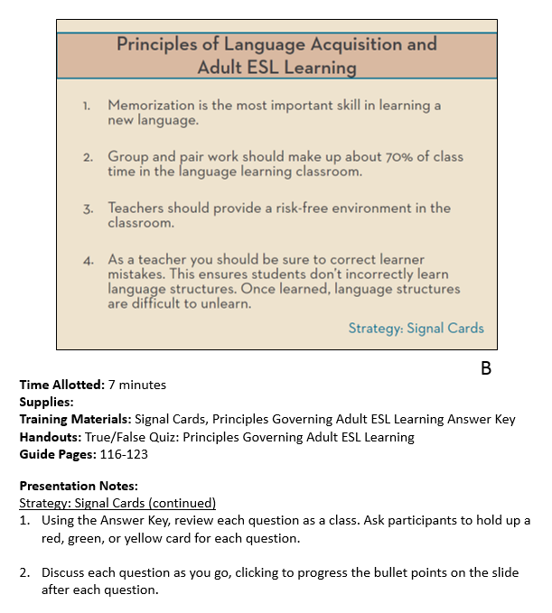
Overview of Slide
Organization
  Trainers
Notes:
Time Allotted: 1 minute
Supplies:
Training Materials:
Handouts:
Guide Pages:
Presentation Notes:
Designates which trainer is responsible for the slide

Slide 15
Overview of Slide
Organization
  Trainers
  Timing
Notes:
Time Allotted: 1 minute
Supplies:
Training Materials:
Handouts:
Guide Pages:
Presentation Notes:
How much time the slide is anticipated to take.

Slide 16
Overview of Slide
Organization
  Trainers
  Timing
  Supplies
Notes:
Time Allotted: 1 minute
Supplies:
Training Materials:
Handouts:
Guide Pages:
Presentation Notes:
Any supplies, such as tape, dry erase board, etc.

Slide 17
Overview of Slide
Organization
  Trainers
  Timing
  Supplies
  Training Materials
Notes:
Time Allotted: 1 minute
Supplies:
Training Materials:
Handouts:
Guide Pages:
Presentation Notes:
Any training materials needed to carry out activities
The training materials are items that you keep as a trainer and can reuse in future trainings. They are not items participants take home.

Slide 18
Overview of Slide
Organization
  Trainers
  Timing
  Supplies
  Training Materials
  Handouts
Notes:
Time Allotted: 1 minute
Supplies:
Training Materials:
Handouts:
Guide Pages:
Presentation Notes:
Handouts that participants need to participate in activity on slide.

Slide 19
Overview of Slide
Organization
  Trainers
  Timing
  Supplies
  Training Materials
  Handouts
  Guide Pages
Notes:
Time Allotted: 1 minute
Supplies:
Training Materials:
Handouts:
Guide Pages:
Presentation Notes:
The pages in the guide that cover the information on the slide.

Slide 20
Overview of Slide
Organization
  Trainers
  Timing
  Supplies
  Training Materials
  Handouts
  Guide Pages
  Notes
Notes:
Time Allotted: 1 minute
Supplies:
Training Materials:
Handouts:
Guide Pages:
Presentation Notes:
The main points that are covered for each slide.

Slide 21
COMMON QUESTIONS
Frequently Asked Questions from Participants
How will English Forward help me manage a multi-level class?
How will English Forward help me build student engagement and get students talking to each other, even with classes with only 1 or 2 students?
How can I incorporate English Forward into my existing curriculum?
Notes:
Time Allotted: 5 minute
Supplies:
Training Materials:
Handouts:
Guide Pages:
Presentation Notes:
Thank participants for attending.

Slide 22
How can you get involved?
English Forward Institutes
  Three-day in-person training, including a TOT
  July 27 - 29 in Austin, TX
  Aug 31 - Sept 2 in Chicago, IL
  $500 license fee to help cover our costs
    Payment can be delayed for agencies that cannot pay immediately
    Add’l costs for access to the Literacy Forward Web Portal
  Dollar General Literacy Foundation is covering the majority of the cost
    $200 travel stipend per participant to help cover travel costs
Notes:
Time Allotted: 1 minute
Supplies:
Training Materials:
Handouts:
Guide Pages:
Presentation Notes:
Tell participants how they can get involved and take English Forward to their communities.

Slide 23
Thank You!
For more information or to ask a Literacy Forward-related question, please visit:
www.literacyforward.org
Justin DeBrosse
Director of Instructional Quality
jdebrosse@willread.org
(512) 326-8655 x.104
To access this presentation and all materials, visit www.literacyforward.org/paace
Notes:
Time Allotted: 1 minute
Supplies:
Training Materials:
Handouts:
Guide Pages:
Presentation Notes:
Thank participants for attending.
B

