Slide 1
Connecting Oral and Written English for Adult ESL Students The Writing is on the Wall
Karen Green, El Buen Samaritano
Justin DeBrosse, Literacy Coalition of Central Texas
Notes:
We’ve probably all experienced the situation when students are speaking pretty well, but they are not able to comprehend what they read, even if they understand when it is read to them.
So it seems obvious that we should put some focus on connecting oral and written skills, but they are mismatched making leveled textbooks difficult to use for some learners.

Slide 2
hɪl vs. hi:l
He stood on the _______ and looked at the valley below.
?

Slide 3
Assessment and placement challenges
Learners sometimes only assessed on oral proficiency leaving literacy out
Some students prefer to be in a lower English level due to low English literacy
Notes:
Some students tell me in English that they want to “start from the beginning” because they don’t read and write it. This either means that they do not have literacy in their native language, or they are just saying they don’t understand English rules enough to decode reading, spelling, etc.

Slide 4
Characteristics of our students
Native language literacy
Years of schooling in their native country
Exposure to English outside classroom
Literacy in English
Notes:
“Huntley (1992) argues that the following types of L1 literacy background should be considered in adult ESL education: preliterate, non-literate, semiliterate, and non-Roman alphabet literate.”
From English Forward: Highlight the following points, advancing the slide one circle at a time:
Years of schooling: A person’s educational background is the factor that weighs most heavily in determining how quickly they will advance and the level of support they’ll need along the way. Students with more schooling in their home countries will progress more quickly than those with less, and the more schooling a student has, the more quickly they will become bored with learning the basic life skills others need to learn.
Native language literacy: Some may speak English well because they picked it up on the street but may never have received a formal education. These students will struggle with reading and writing.
Literacy in English: Still others may have learned to read English in their home countries but they may never have learned to speak the language.
Exposure to English outside class: For those who have been exposed to English outside of class, their oral communication skills will progress more quickly than those with less exposure.

Slide 5
Sociological context: Mexico and Central Texas
71% of population of Mexico enrolls in secondary school, while 99% enroll in primary school (UNICEF country statistics 2012)
Approximately 50% of adult students (95% from Mexico and Central America) at El Buen Samaritano have below a high school education
Notes:
Why was literacy a “new field” in adult education the 1990s in the U.S.? Reference to Heide study. Because of which immigrants started coming to the U.S. In the 1970s, it was immigrants from Southeast Asia. In the 80s, it was refugees from Central America, who did not have access to formal education.
Interagency Literacy Council Report
In 2007 there were 3.9 million Texans eligible for adult education services. A little over half a million Texans eligible for adult education had an educational level at fourth grade or below, and most of them required ESL training. There were over one million Texans whose educational levels ranged from fifth to eighth grade, about half of whom required ESL. (2012)

Slide 6
Possible solution: Reading and Writing Class for High Level Speakers
Score at least SPL 4 on BEST Plus
Did not complete 9 years of formal schooling
Are at least semi-literate in their first language
Notes:
Students who score at least SPL 4 are able to:
Students with less than 9 years of formal education normally have some holes in their general knowledge and not much exposure to native language books in adulthood.
If they are literate in their first language, they will be able to relate to some grammatical structures if L1 is similar to English with tenses, punctuation, similar parts of speech.
Assumption is that students are at least semi-literate “Huntley (1992) argues that the following types of L1 literacy background should be considered in adult ESL education: preliterate, nonliterate, semiliterate, and non-Roman alphabet literate.”

Slide 7
Reading for what?
Reading can be social
Reading should be relevant to students’ lives
Explicit and direct reading instruction will connect oral and written language
Notes:
“and writing adults practice in "real-life." This approach has been challenged extensively. There is now a growing consensus that "real life" reading should be the starting point rather than the ending point of teaching initial literacy and that skills such as phonics should be used as a tool in helping learners understand the "print" they see around them.” (Huntley 1992?)
This presentation focuses on reading, which naturally leads to writing (note taking, free writing with journals, responding to prompts, brainstorming, writing summaries, writing a new ending to a story, BEING CREATIVE with language.

Slide 8
The Reading Process
From decoding to comprehension
Notes:
What can we do to help students with strategies when comprehension breaks down?
Often with new ESL teachers who have not received a lot of training, they will assume that their students are reading when they do round robin reading aloud, but a lot of times, those students are just sounding out the words and not comprehending what they are saying.

Slide 9
How can ESL teachers get more training in teaching literacy skills?
Notes:
In person trainings with opportunities to try out teaching strategies might be available to you like Adult Basic Literacy Forward, developed by the Literacy Coalition of Central Texas.
What is available in your area?

Slide 10
Teaching Strategies for Connecting Oral and Written English through Explicit Instruction and Modeling
Using pictures/picture stories
Powerpoint
Predicting
Language Experience Approach
Using music
Using monolingual English dictionaries
Choral and echo reading
Notes:
Give examples of each strategy and mention Adult Basic Literacy Forward and English Forward
Using pictures – small amounts of text related to each picture in order to facilitate comprehension and form images
Predicting – pre-reading exercise that is included in most textbooks, but sometimes overlooked as a way to connect and engage students with the reading.
LEA
Using music – Use songs students know and give them a way to connect to the written lyrics.

Slide 11
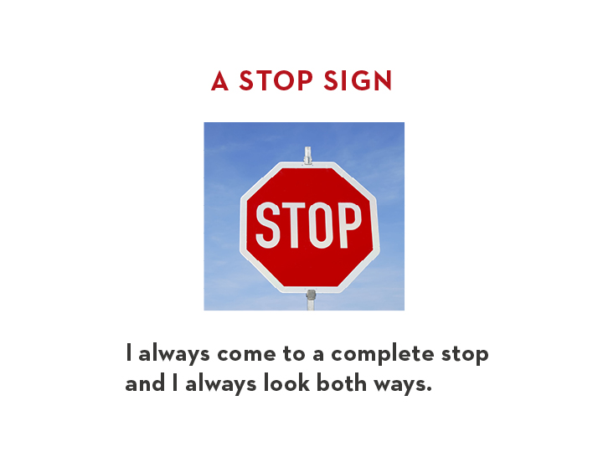
Notes:
“I always come to a complete stop and I always look both ways.”
B

Slide 12
Notes:
“I always stop at a red light. I never run a red light. Well, sometimes I run a red light if I am late to work.”
Optional: If you have a watch, point to it and look worried.
B

Slide 13
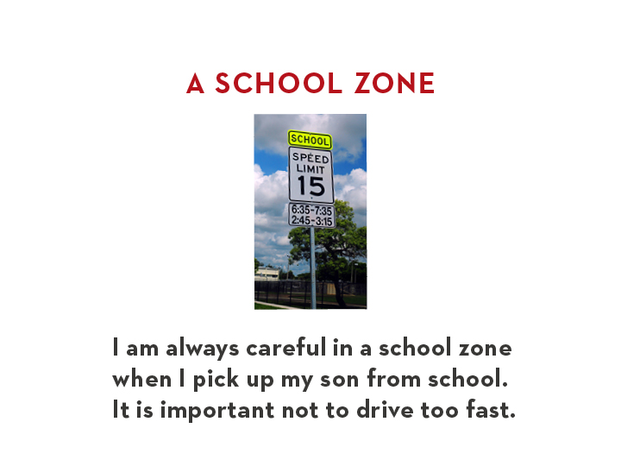
Notes:
“I am always careful in a school zone when I pick up my son from school. It is important not to drive too fast.”
B

Slide 14
Notes:
“One time I ran a red light when I was late for work.”
B

Slide 15
Notes:
“A police officer was there. He pulled me over for running the red light.”
B

Slide 16
Notes:
“The police officer asked to see my license and registration. Then he gave me a ticket.”
Optional: Show copies of a license and registration.
B

Slide 17
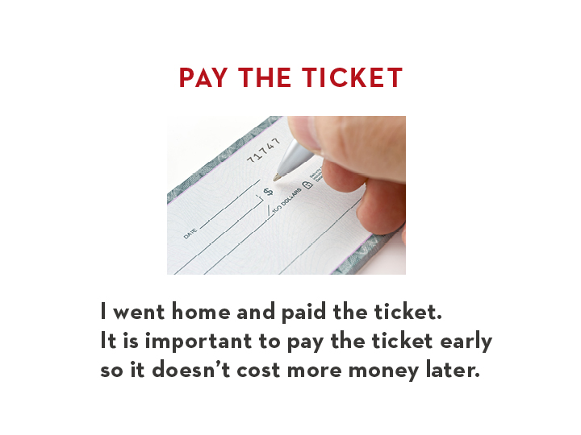
Notes:
“I went home and paid the ticket. It is important to pay the ticket early so it doesn’t cost more money later.”
Optional: Show a checkbook.
B

Slide 19
Sweat the Small Stuff
Phonics – word families, word endings
Spelling – rules and exceptions
Pronunciation – syllables, silent letters,
Inflection – showing emotion, when asking a question or showing preference
Punctuation – for effect, to show beginning and end, to link words
Grammar and syntax
Notes:
Modeling all of these
Back to basics for higher level student

Slide 20
Brain Movies – A Sign of Comprehension
Select a text with vivid language to read aloud.
Introduce new words before reading. Connect to images or websites.
Connect to what students know
Invite students to create a movie in their heads to go with what you read
Have students retell the story from what they remember
from Edutopia.com

Slide 21
Resources for Teaching Reading
The Change Agent – Adult Education newspaper for social justice
New Readers Press/ProLiteracy News for You
The Times in Plain English
Voice of America News
True Stories series from Pearson Education
From Reading to Writing from Pearson Education
Illustrated non-fiction children’s stories
Adult non-fiction with inspiring stories of struggle
Notes:
It needs to be relevant, with some way for students to connect the story to their lives
The Times in Plain English also has audio

Slide 22
Reading Aloud and Book Clubs
Practice reading with expression to model intonation, emotion, phrasing
Ask for opinions while you read
Getting the gist builds confidence
Reading, Writing, and Relationships
Notes:
Read from Carrie Sell’s “Reading, Writing and Relationships”

Slide 23
References
Center for Applied Linguistics (2003). “Reading and Adult English Language Learners: A Review of the Research”
http://www.unicef.org/infobycountry/mexico_statistics.htm
http://www.twc.state.tx.us/files/partners/texas-interagency-literacy-council-report-twc.pdf
Literacy Coalition of Central Texas, English Forward Training
Wrigley, H. (2008) “The What Works Study: Instruction, Literacy and Language Learning for Adult ESL Literacy Students” from http://www.literacywork.com/
“Reading, Writing and Relationships” Carrie Stell, Grayson College

Slide 24
Thank you
Justin DeBrosse
Director of Instructional Quality
Literacy Coalition of Central Texas
jdebrosse@willread.org
(512) 326-8655 x.104
Karen Green
Family Literacy Manager
El Buen Samaritano, Austin
kgreen@elbuen.org
(512) 439-0739

