Slide 1
October 28, 2016
TexTESOL 2016 State Conference
Austin, Texas
Teaching Adult ESL Students to Succeed in Courageous Conversations
Justin DeBrosse, Literacy Coalition of Central Texas
Karen Green, El Buen Samaritano
Notes:
Time Allotted: 5 minutes
Supplies:
Training Materials:
Handouts:
Presentation Notes:
Welcome & Introductions
Welcome everyone and thank them for attending
Presenter introductions [state your name, organization, & role]
Give a brief description of the Literacy Coalition and El Buen Samaritano.
Literacy Coalition:
- Nonprofit founded in 2001
Mission: to improve the quality and availability of literacy instruction for Central Texans
An umbrella organization that supports over 40 literacy agencies and programs by providing: resources, training, research, advocacy
To learn more about the Literacy Coalition or El Buen Samaritano, direct participants to our websites.
Justin & Karen

Slide 2
Outline
Introduction
The Challenge
Our Answer:
English Forward
Lesson Flow
Sample Lesson
Q&A
Notes:
Time Allotted: 1 minute
Supplies:
Training Materials:
Handouts:
Presentation Notes:
Go over the outline of the presentation, telling participants about the major components of the presentation.

Slide 3
The Challenge
Our students often lack the means to advocate for themselves in many situations.
Police Officers
Landlords
Employers
Notes:
Time Allotted: 3 minutes
Supplies:
Training Materials:
Handouts:
Presentation Notes:
Define the problem – people who don’t speak English lack the ability to advocate for themselves in many situations
Culture and language are indelibly linked. When someone learns English, knowing HOW TO USE the language is just as important as knowing the language itself.
Just like we do, they often come into contact with individuals in positions of authority, such as police officers, landlords, and employers, just to name a few. So what do we do for students who live in our community, deal with the same barriers that we do (and more!), but lack the cultural competency to succeed, in addition to lacking the ability to use English proficiently?

Slide 4
English Forward Training System
Developed by the Literacy Coalition of Central Texas in collaboration with Dr. Heide Spruck Wrigley
1st edition developed in 2008; 3rd (current) edition developed in 2012; training system replication piloted nationwide in 2013
Reflects the most recent research in the field of adult second language acquisition
Developed with input from students, teachers, and programs
Developed at the request of and to meet the needs of community-based organizations
Limited resources
Volunteer instructors with no prior teaching experience
Notes:
Time Allotted: 2 minutes
Supplies:
Training Materials:
Handouts:
Presentation Notes:
The way that we address this challenge is through the English Forward Lesson Flow, part of the English Forward Training System.
Briefly introduce the English Forward Training System by reviewing the slide.
Refer participants to the web portal for more detailed information about the English Forward Training System.
B

Slide 5
The English Forward Curriculum
Overview:
Developed in 2012; 3rd edition of the training system
Developed at the request of CBOs
and with their needs in mind
Developed in consult with Dr. Heide Wrigley
Only available to English Forward-trained instructors
Notes:
Time Allotted: 2 minutes
Supplies:
Training Materials: English Forward Curriculum (“EFC”)
Handouts:
Presentation Notes:
Introduce the EFC by briefly covering the following points on the slide:
It was developed by the Literacy Coalition in 2012 as part of the 3rd edition of the training system
The intermediate level of curriculum is in development, with much more focus on work readiness.
It was developed at the request of community-based programs with their needs in mind: limited resources and mostly volunteer instructors
It was developed in consult with Dr. Heide Wrigley.
Effectively implementing the EFC requires those using it to already be familiar with many of the principles covered during the English Forward Instructor Training, such as the Lesson Flow and teaching strategies. Therefore, it is only available to those instructors who attended the 2-day instructor training.
B

Slide 6
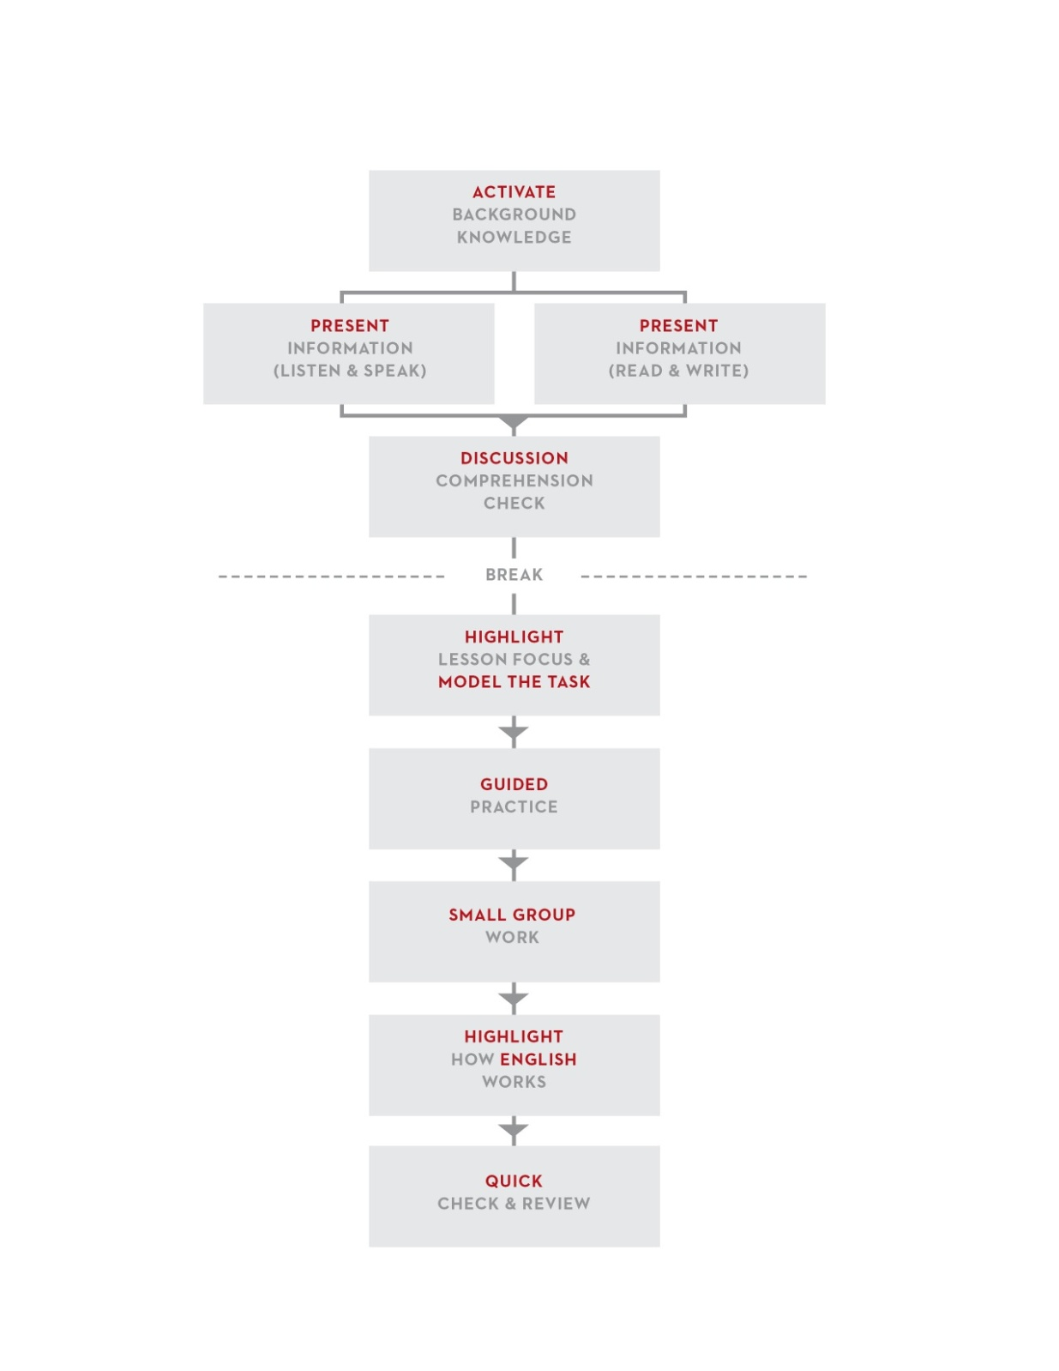
The English Forward Lesson Flow
Lesson Flow adapted from ESL by Design by Literacywork International
Notes:
Time Allotted: 5 minutes
Supplies:
Training Materials:
Handouts: The Lesson Flow
Presentation Notes:
Pass out the Lesson Flow handout.
Give a brief overview into the background of the Lesson Flow, highlighting the following points:
The entire English Forward training system, including the Lesson Flow, builds upon research and promising practices gathered from studies in cognitive sciences, second language acquisition, learning theory, and adult ESL Literacy.
It is a strategy-based approach to ESL instruction that can be applied for a variety of ESL levels.
It can be used by both experienced and new instructors.
Within a two-hour class period, instructors are encouraged to go through the lesson flow once and focus on listening and speaking and then go through the flow a second time and focus on reading and writing.
It is meant to be flexible and not content specific. It is intended to provide a framework for ESL instruction that can be manipulated to meet the specific needs of teachers and students.
The English Forward training system focuses on teaching oral communication skills; therefore, the training and accompanying Curriculum focus on the listening and speaking side of the diagram.
However, we are currently developing the next level of English Forward curriculum, and this level will incorporate more reading and writing components than the beginning level.
B

Slide 7
Lesson 8.3 A Traffic Stop
Strategy: Teaching with PPT
Notes:
Time Allotted: 8 minutes
Supplies:
Training Materials:
Handouts: EFC Lesson 8.3
Presentation Notes:
Strategy: Teaching with PPT
Give each participant a copy of Lesson 8.3.
Orient everyone to the lesson by covering the topic, objectives, and Step 1.
Demonstrate Teaching with PPT: Model Step 2 of the lesson.
Run through the presentation twice just as you would in class:
A

Slide 8
Notes:
“This is my car. I am a good driver.”
B

Slide 9
Notes:
“I always come to a complete stop and I always look both ways.”
B

Slide 10
Notes:
“I always stop at a red light. I never run a red light. Well, sometimes I run a red light if I am late to work.”
Optional: If you have a watch, point to it and look worried.
B

Slide 11
Notes:
“I am always careful in a school zone when I pick up my son from school. It is important not to drive too fast.”
B

Slide 12
Notes:
“One time I ran a red light when I was late for work.”
B

Slide 13
Notes:
“A police officer was there. He pulled me over for running the red light.”
.
B

Slide 14
Notes:
“The police officer asked to see my license and registration. Then he gave me a ticket.”
Optional: Show copies of a license and registration.
B

Slide 15
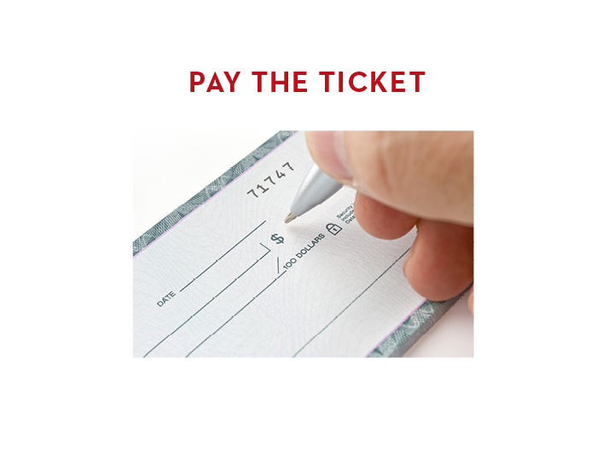
Notes:
“I went home and paid the ticket. It is important to pay the ticket early so it doesn’t cost more money later.”
Optional: Show a checkbook.
B

Slide 16
Notes:
“This is my car. I am a good driver.”
B

Slide 17
Notes:
“I always come to a complete stop and I always look both ways.”
B

Slide 18
Notes:
“I always stop at a red light. I never run a red light. Well, sometimes I run a red light if I am late to work.”
Optional: If you have a watch, point to it and look worried.
B

Slide 19
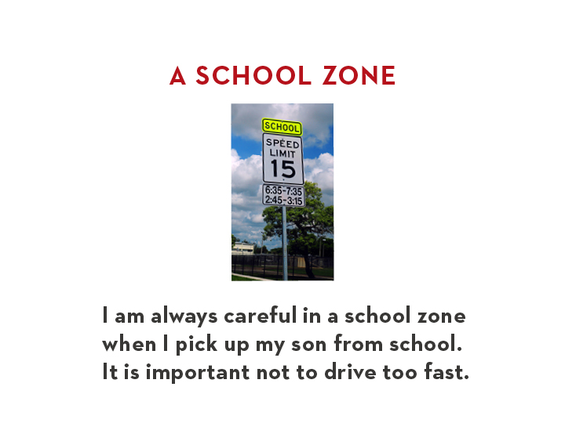
Notes:
“I am always careful in a school zone when I pick up my son from school. It is important not to drive too fast.”
B

Slide 20
Notes:
“One time I ran a red light when I was late for work.”
B

Slide 21
Notes:
“A police officer was there. He pulled me over for running the red light.”
B

Slide 22
Notes:
“The police officer asked to see my license and registration. Then he gave me a ticket.”
Optional: Show copies of a license and registration.
B

Slide 23
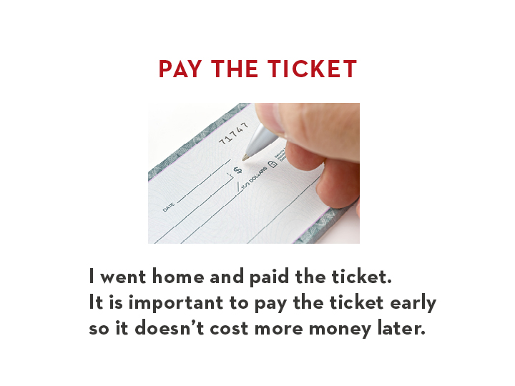
Notes:
“I went home and paid the ticket. It is important to pay the ticket early so it doesn’t cost more money later.”
Optional: Show a checkbook.
B

Slide 24
Lesson 8.3 A Traffic Stop
Strategy: Teaching with PPT
Notes:
Time Allotted: 3 minutes
Supplies:
Training Materials:
Handouts: EFC Lesson 8.3
Presentation Notes:
Strategy: Teaching with PPT
Discuss Step 2 of the lesson flow, Mini-Presentation with Prompt. Remind participants that this is the point in the lesson where you supply the students with the language that they will need to be able to use later.
Briefly touch on Step 3, Quick Check and Review. This is where we make sure the students understood the vocabulary from Step 2 before moving on.
A

Slide 25
Steps 4-6 of the lesson
Notes:
Time Allotted: 10 minutes
Supplies:
Training Materials:
Handouts:
Presentation Notes:
Direct participants to Steps 4-6 of the lesson.
Describe the continuum of Steps 4-6, in which students go from relying entirely on the instructor for modeling and in put in Step 4 to being independent in their practice of the task by Step 6.
Ask participants to take a look at steps 4-6 and think about how the structure and flow of the activities helps students to learn what they need to do in this situation and how it would empower them to succeed in situations like this. (5-10 minutes)
Come back together and ask participants to share what they discussed.
Describe the flexibility of the activities in Steps 4-6 and how they can be modified to meet students at any proficiency level, so as to provide them with practice they’re comfortable, knowledge of how to handle a situation such as this, and practice performing the culture in this context.

Slide 26
To Learn More
Literacy Forward Web Portal – www.literacyforward.org
Literacywork International – www.literacywork.com

Slide 27
Q & A
Notes:
Time Allotted: 5 minutes
Supplies:
Training Materials:
Handouts:
Guide Pages
Presentation Notes:
B

Slide 28
Thank You!
For more information or to ask a Literacy Forward-related question, please visit:
www.literacyforward.org
Justin DeBrosse
Director of Instructional Quality
Literacy Coalition of Central Texas
jdebrosse@willread.org
(512) 326-8655 x.104
Karen Green
Family Literacy and Social Services Manager
El Buen Samaritano
kgreen@elbuen.org
(512) 439-0739
Notes:
Time Allotted: 1 minute
Supplies:
Training Materials:
Handouts:
Presentation Notes:
Thank participants for attending.
B

